Slide 1
Insider Threat in the Age of COVID
Counterintelligence Awareness

Slide 2
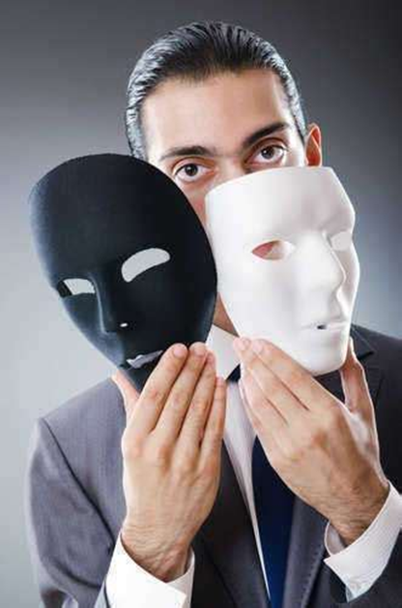
Insider Threat Definition
What is an Insider Threat?
The threat presented by a person who has, or once had, authorized access to information, facilities, networks, people, or resources; and who wittingly, or unwittingly, commits: acts in contravention of law or policy that resulted in, or might result in, harm through the loss or degradation of government or company information, resources, or capabilities; or destructive acts, to include physical harm to others in the workplace.

Slide 3
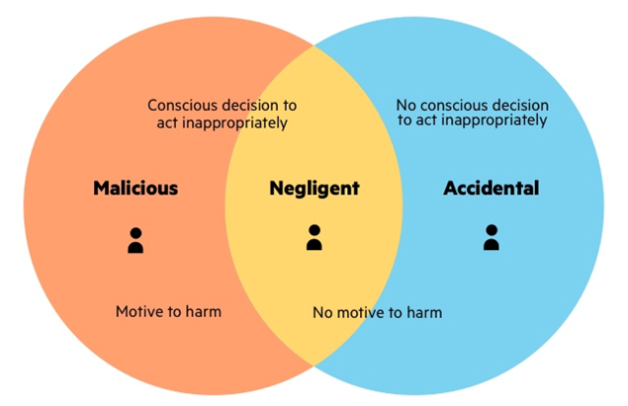
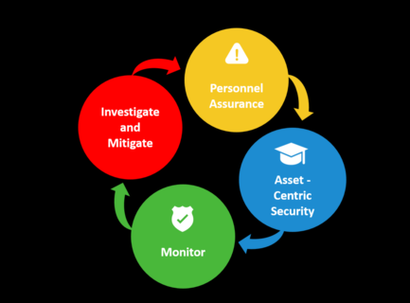
Types of Insider Threats
Unintentional Insider Threat
The most prevalent type of insider threat
Distraction
Negligence
Lack of security awareness
Malicious Insider Threat
Willingly, intentionally, and/or nefariously engages in activity for financial or personal gain
Data brokering is a $200 billion dollar industry
Data is power, money, influence
Notes:
Tessian.com/blog/what-is-an-insider-threat/

Slide 4
Spectrum of Behavior
Usually a spectrum of behavior that follows a continuum of idea to action
Prolonged stress may increase anxiety, impulsivity, impair judgment and may lead people to become negative and distort their experiences
Finance is a major motivator, particularly as pandemic constrains or wipes out finances, savings, IRAs, and 401Ks
Anxiety and stress may cause individuals to cut corners or not be attentive to security policy and practices
In crises, catastrophizing of experiences may cause hopelessness and lead to impulsiveness
Increases with major stressors such as realignment, acquisition, mergers, or divestitures
Notes:
Tessian.com/blog/what-is-an-insider-threat/

Slide 5
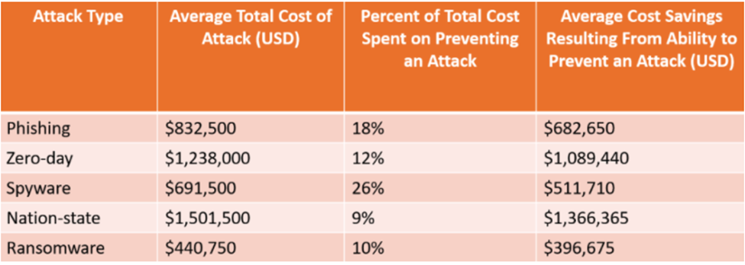
Statistics
Ponemon Institute-Insider Threats rose an incredible 47% from 2018-2020
Average cost increased by 31% since 2018
In 2020, 11.45 million dollars
Global Cybercrime costs reached 1 trillion in 2020
70 orgs surveyed by Skybox identified 1/3 of employees would telecommute for 18 more months
Notes:
https://latesthackingnews.com/2020/11/30/how-to-deal-with-insider-threat-in-the-age-of-covid-19/

Slide 6
COVID Threat Atmosphere
Cybercriminals target the human, not the tech
Email attachments
Credentials theft
300% increase in cybercrime
3000-4000 cybersecurity complaints daily
Microsoft observed 16 nation-states leverage the COVID-19 crisis for their benefit in the cybersecurity realm
Google’s Threat Analysis Group blocked 18 million COVID-19 themed malware and phishing emails per day in April 2020
Ransomware Gangs emerged as most common threat
Based off the Wannacry hack in 2017
Origins in North Korea
2019-attacks increased 200%
Notes:
https://www.engadget.com/fbi-cybercrime-complaints-increase-fourfold-covid-19-091946793.html
https://www.upi.com/Top_News/US/2020/10/19/Cyberthreats-growing-more-sophisticated-harder-to-find-experts-say/2801602867227/

Slide 7
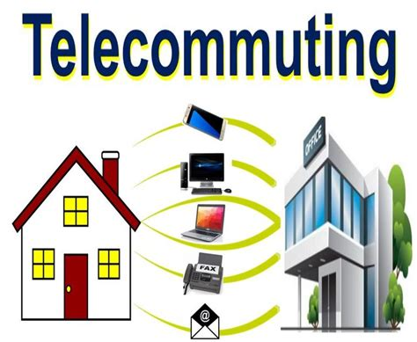
After-Effects of Telecommuting
Hastily configured remote work policies fueled cybersecurity challenges
Threat actors capitalized on the following:
Protocols
Online tools
Unfamiliar forms of communications
Overall lack of familiarity
Blurring of line between personal/professional
Lack of understanding of Cyberthreats and vulnerabilities
Increased the risk of social engineering, malware, &
ransomware attacks
Notes:
https://www.investopedia.com/what-is-tiktok-4588933

Slide 8
Vulnerabilities
Weak links are home routers and computers
Password hygiene is poor in the best of times
Remote employees thrust into new working environments with no face-to-face supervision and little to no training for handling new security risks
Distractions
Balancing home/work life when employee and family are using shared spaces to accomplish work/school/free time
Distractions increase chance of becoming a UIT
Company equipment is in the home, with potential access by family, friends, etc
Protect access
Not appropriate to leave company equipment in a car overnight
Physical Documents
Protect all docs printed related to work, lock up if you work in a shared space from home
Notes:
Securitymagazine.com/articles/92606-how-to-minimize-the-risk-of-insider-threats-physical-and-cyber-during-covid-19

Slide 9
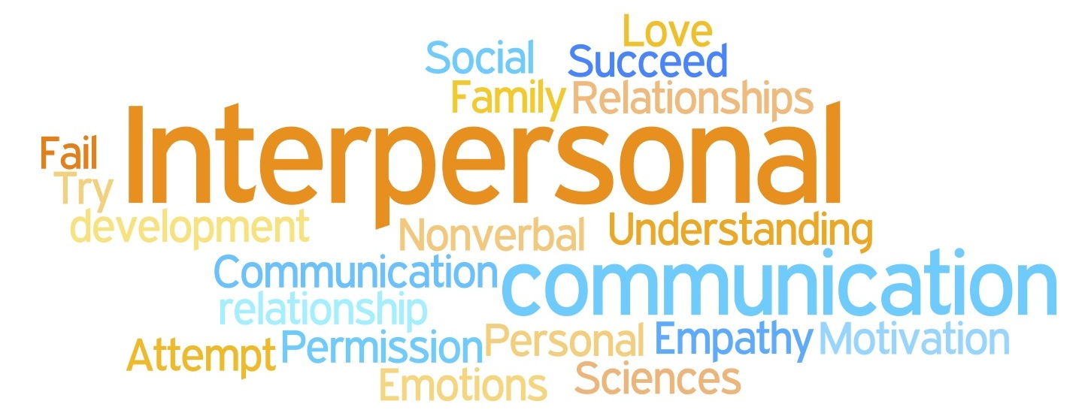
Vulnerabilities
Remote employees were granted greater data security responsibility with less direct oversight
Valuable insights to interpersonal observations and engagement are now limited or virtually non-existent
Notes:
Securitymagazine.com/articles/92606-how-to-minimize-the-risk-of-insider-threats-physical-and-cyber-during-covid-19

Slide 10
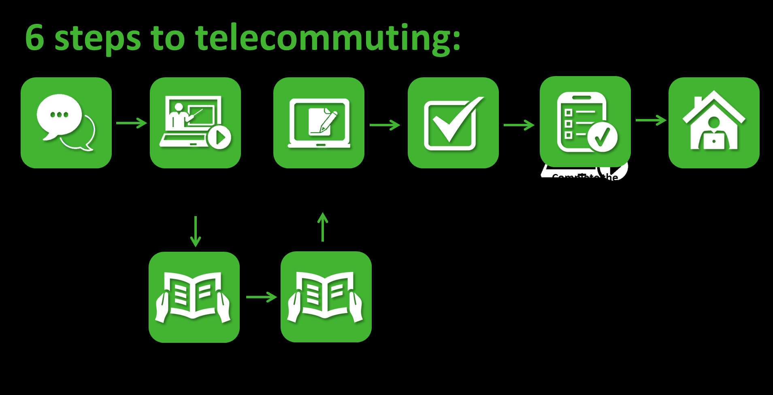
Mitigations
Look for behavioral risk indicators
Use perimeter protection
Ensure VPN use
Security Education Training Awareness
Defense in depth
Incentivize positive behaviors
Prohibit retention of proprietary in the home
Maintain a clear/clean workspace at home
Lock laptop upon leaving workspace
Notes:
https://www.investopedia.com/what-is-tiktok-4588933

Slide 11
Supervisor/Manager Potential Actions
Monitor Stress Factors in employee’s lives
Supervisors/manager are frontline eyes and ears here
Connect coworkers to each other
Establish core hours to enable socialization among employees
Allow the remainder to work ‘at will’
Stress flexibility
Take avid interest in employee well-being
Re-learn employee’s behavioral baseline
Ensure employees are reassured of job security, promotion opportunities, and
Notes:
https://www.investopedia.com/what-is-tiktok-4588933

Slide 12
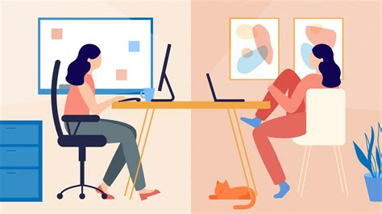
Tips for Working From Home
Update Home WIFI with a strong password
Use numbers and letters
Never click on COVID-19 related attachments outside your trusted perimeter
Double Check Links
Ensure the links go to the correct domain
Update usernames and passwords on trusted sites only
Don’t reuse passwords
Do not use personal devices at home to access
organization networks, data, or emails
Notes:
Mimecast.com/globalassets/cyber-resilience-content/100-days-of-coronavirus-threat-intelligence.pdf

Slide 13
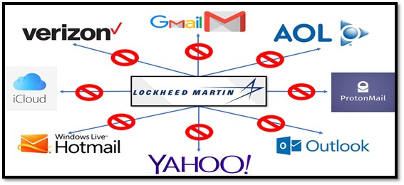
Don’t Be a Negligent Insider
Protect your laptop and any printed Proprietary Info
Do not print what you do not need
Lock and log off if you share a household
Use only approved file transfer methods
Don’t email to your personal email unless approved
Could be in violation of company’s policy
Report suspicious email activity to CI Team
Notes:
Mimecast.com/globalassets/cyber-resilience-content/100-days-of-coronavirus-threat-intelligence.pdf

Slide 14
2020 Case Studies
March 2020-Chris Dobbins
May 2020 Roblox Incident
July 2020-Jean Patrice Delia
July 2020-Vishing Scam
Notes:
Mimecast.com/globalassets/cyber-resilience-content/100-days-of-coronavirus-threat-intelligence.pdf

Slide 15
Medical Packaging Company-Chris Dobbins
Hacked and sabotaged his company’s electronic shipping records
Cost company $200,000 in damages due to delayed PPE
Why did he do it?
He was terminated from employment in early March 2020
Allowed to continue working until end of the month
What did he do?
Created a fake user profile
Accessed after left the company
Edited 115,581 records
Deleted 2371 more
Notes:
https://www.databreaches.net/insider-threat-former-employee-of-medical-packaging-company-sentenced-to-federal-prison-for-disrupting-ppe-shipments/

Slide 16
Roblox Incident
Hacker used bribery and social engineering to gain access to Roblox systems
Paid an insider threat to lookup user data for them (PII)
Then used LinkedIn to social engineer a phishing email to target a customer support representative
Accessed:
Gamers’ email addresses
Change passwords
Remove two-factor authentication
Ban users
Notes:
Mimecast.com/globalassets/cyber-resilience-content/100-days-of-coronavirus-threat-intelligence.pdf

Slide 17
Jean Patrice Delia
Conspired with Miguel Sernas of Mexico City, Mexico to steal trade secrets from General Electric Company (GE)
Data was advanced computer models created by and used by GE to calibrate turbines
Combined with stolen marketing data and pricing information to compete against his former employers
Pled guilty
Notes:
Mimecast.com/globalassets/cyber-resilience-content/100-days-of-coronavirus-threat-intelligence.pdf

Slide 18
Vishing Scam
Vishing (voice phishing) is a social engineering attack whereby attackers impersonate a trusted entity during a voice call to manipulate their targets into revealing sensitive information
Often use Voice over Internet Protocol (VoIP) as its difficult to track
Use data from LinkedIn and social media platforms to target victims
Professional criminal hacking group offer this as a service targeting specific companies
Present themselves as Corporate IT help desk and attempt to obtain information from employees or convince them to execute malicious files
Also used by advanced persistent threats such as Iranian Charming Kitten and North Korean Lazarus groups
July 2020, Twitter suffered this attack as hackers accessed high profile accounts
Notes:
https://blog.checkpoint.com/2020/11/19/whos-calling-how-to-avoid-being-hooked-by-vishing-the-new-old-school-phone-scam/

Slide 19
Parting Thoughts
“92% of insider threat cases were preceded by a negative work event, such as a termination, demotion, or dispute with a supervisor”
“59% of employees who leave an organization voluntarily or involuntarily say they take sensitive data with them”
Deloitte Insider Issue #6
Mike Gelles and Linda Walsh
Notes:
https://threatpost.com/2020-work-for-home-shift-learned/162595/

